Slide 1
Project Plan Instructions
Team 5 – Kim Gyeongjin, Kim Yejin, Song Jihye, Jang Yoona

Slide 2
Motivations
Even if we don't have cards or board games we can play with right away,
using AR technology, wouldn't we be able to play games with our cell phone anytime, anywhere?
In reality, we don't have a game card
but we can enjoy the game by adding a card image on top of something like white papers.

Slide 3
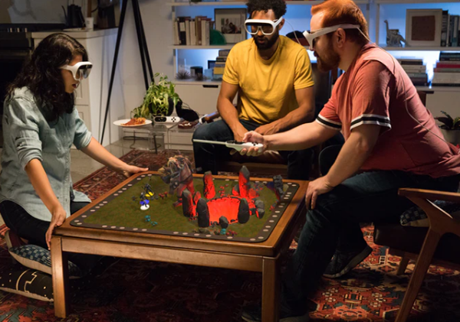
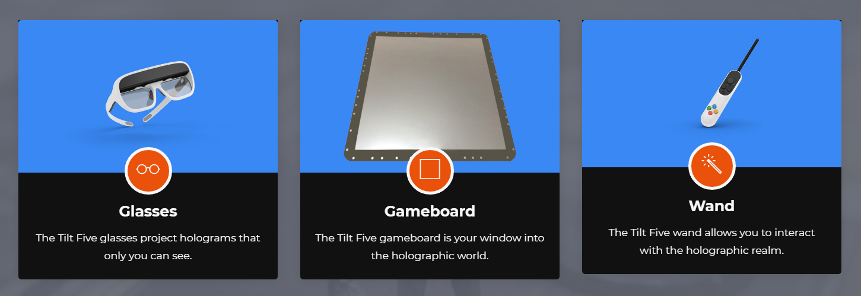
Similar Existing Project – Tilt Five
New board game using AR technology
More vivid through 3D graphic
There are many preparations for AR board games
and they are expensive equipments.
Different from our desire to play games anytime, anywhere
if we have just the players and devices like smartphone.
https://www.tiltfive.com/

Slide 4

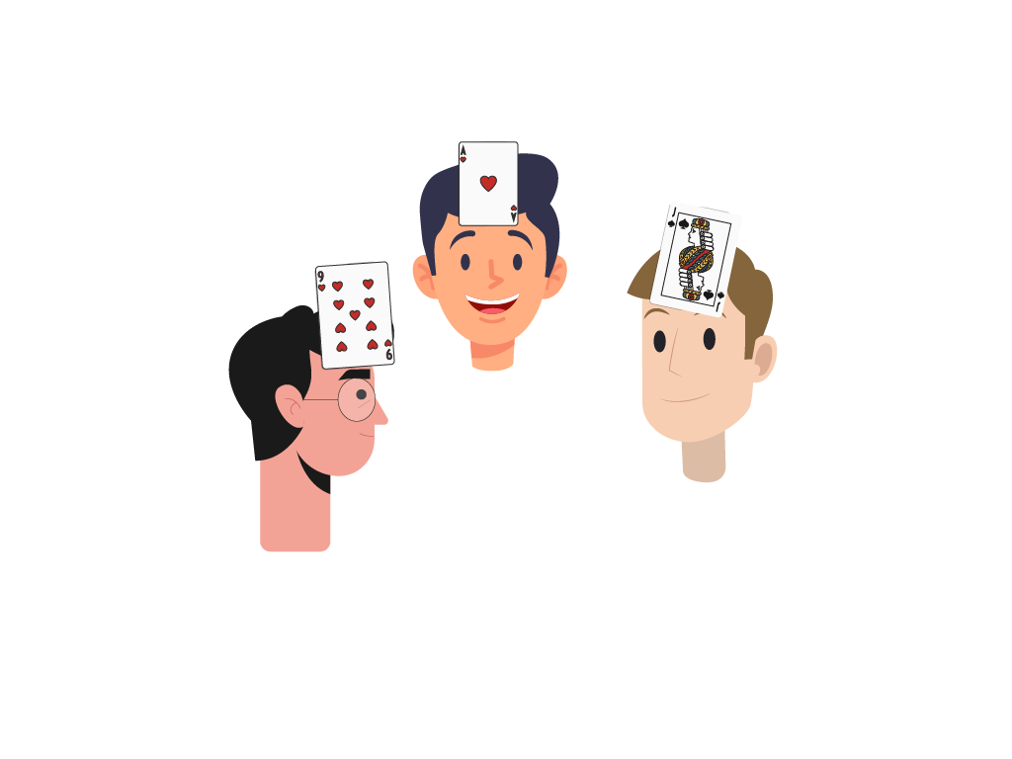

After meeting, we made a goal of providing “AR Indian Poker” game service.
Rule of Indian Poker
1. Each player takes one card
and puts it on his forehead at the same time.
2. The player decides whether to call or die
while only the number of the opponent's cards is known.
Player B
3. Players who have not decided to "die“
will reveal their cards to decide the final winner.
Player C
Player A
The number of card C has is large,
so I have to make him choose "die".

Slide 5
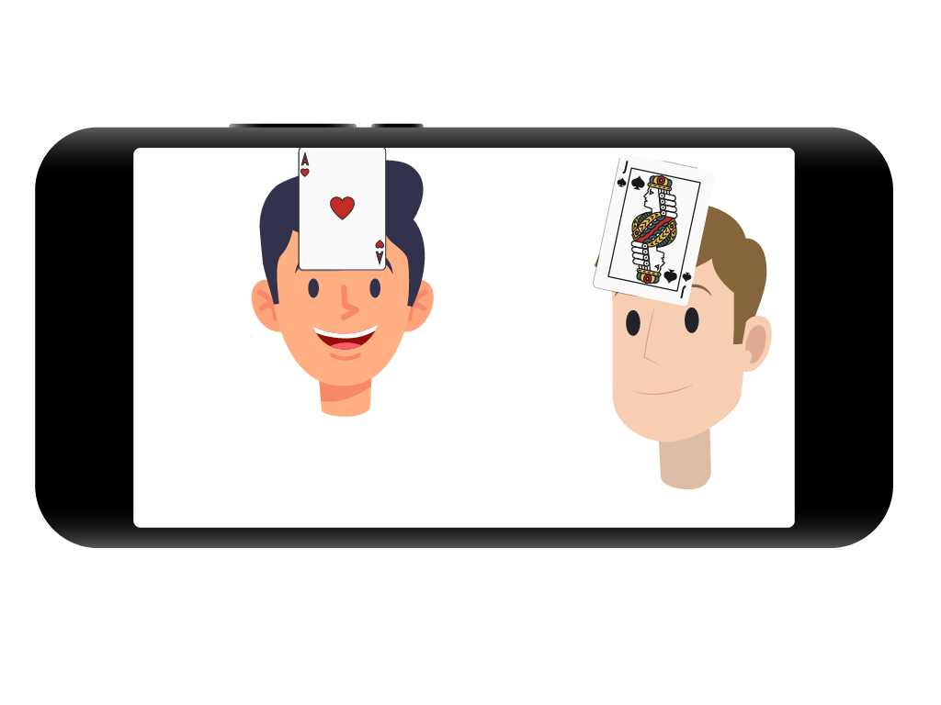
If we apply AR technology to this game...
Image
composed of AR
The real players
and background
Player A’s Perspective
The game program plays the role of a dealer who divides cards.
Each player has his or her own device and is looking at the other player.
It will provide roulette or dice functions to determine the order the players will choose "die" or "call".

Slide 6
Work Division
- Scripting – Kim Gyeongjin, Kim Yejin, Jang Yoona
- Graphics – Song Jihye
*The division of work will be increasingly subdivided as needed as the project progresses
Tools for our project
- Unity
- Git

Slide 7
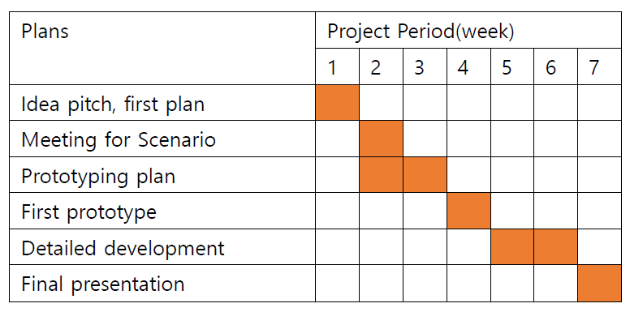
Schedule

